Slide 1
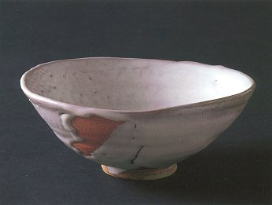
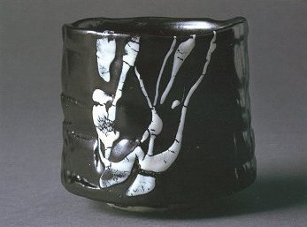
Japanese Tea Bowls
The Chawan

Slide 2
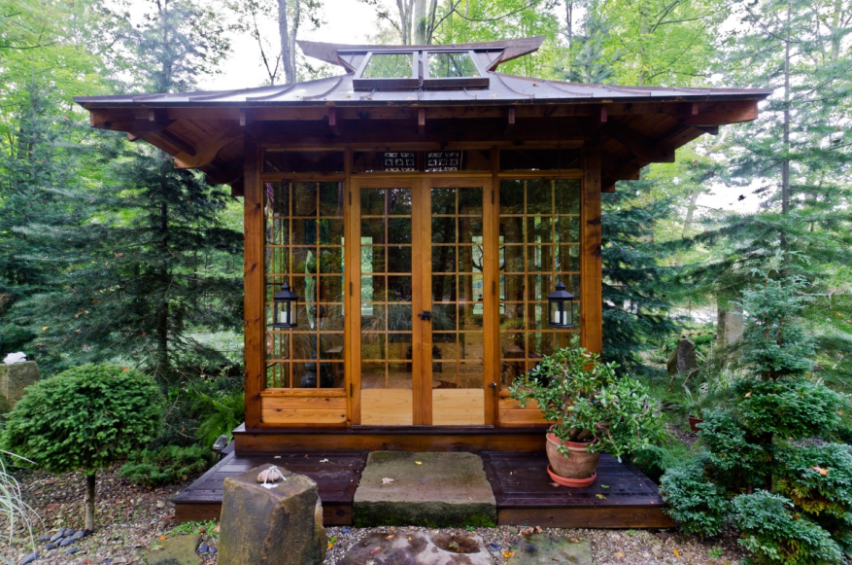
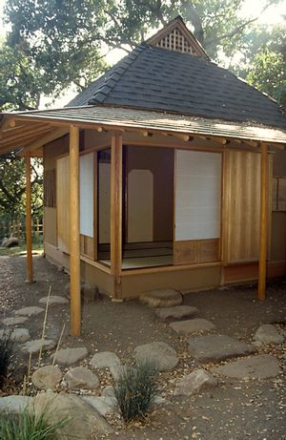
Tea Ceremony
The tea ceremony is one of Japan’s most interesting and enduring artistic traditions. More than a ritual for preparing and drinking tea, the tea ceremony is a means to aesthetic appreciation and social interaction that has had a profound influence on Japanese art, architecture, gardens, cuisine and philosophy.

Slide 3
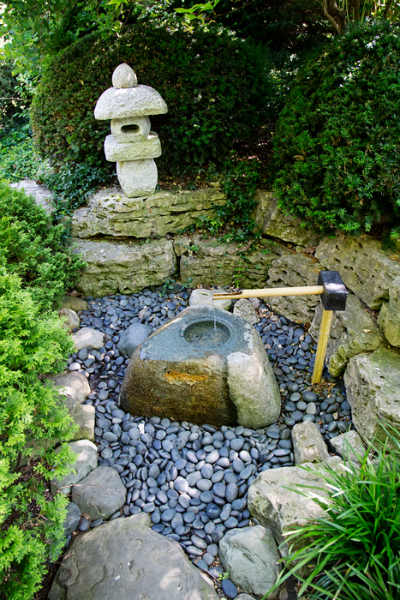
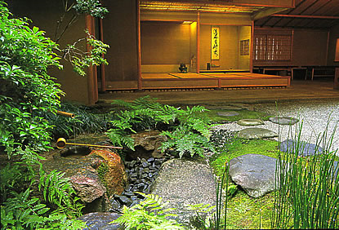
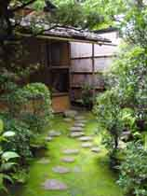
The garden is a quiet shaded place where they wait to be called on by the host
The guests pass through a small garden

Slide 4
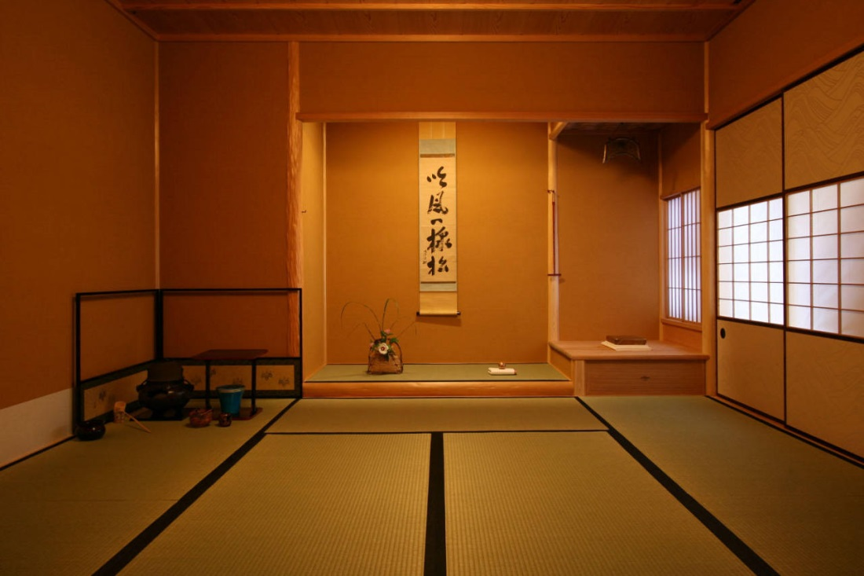
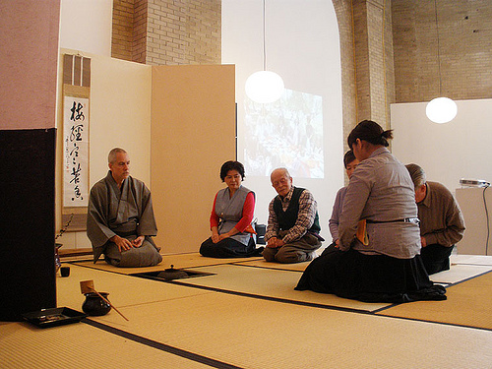
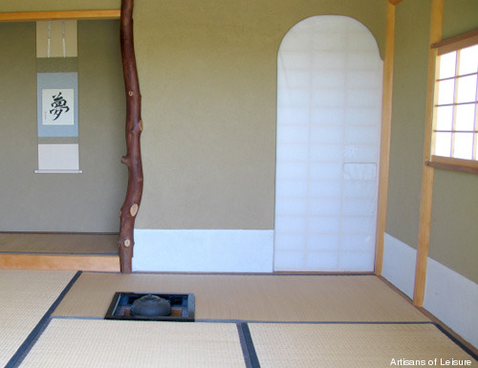
The tearoom is kept empty
    Empty space is
    beautiful and valued
  alter with scroll painting and a flower arrangement

Slide 5
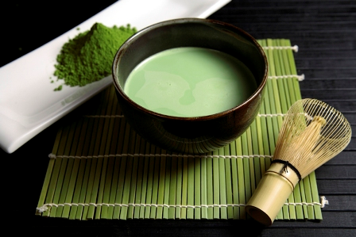
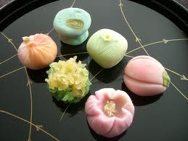
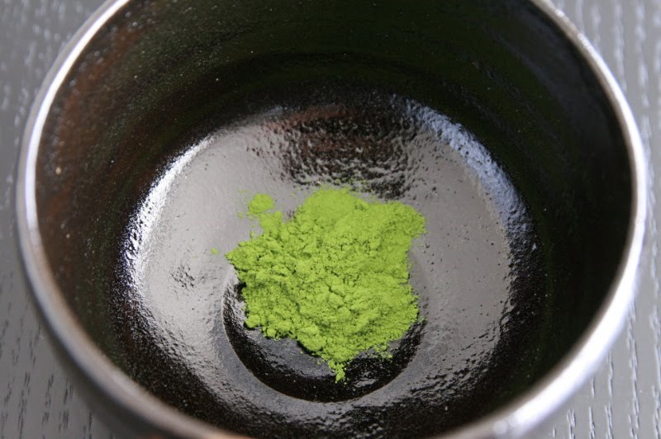
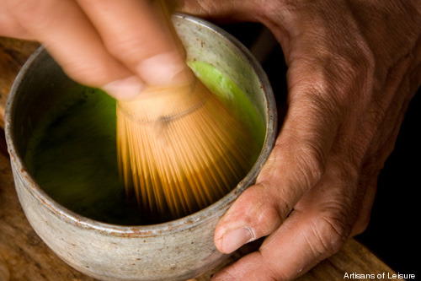
Tea (Matcha) and Sweet (Kashi)

Slide 6
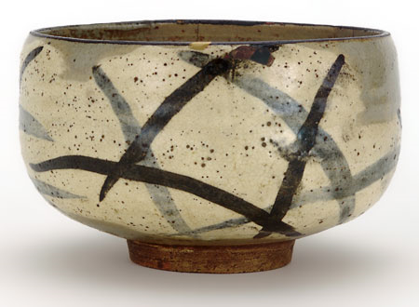
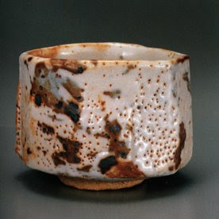
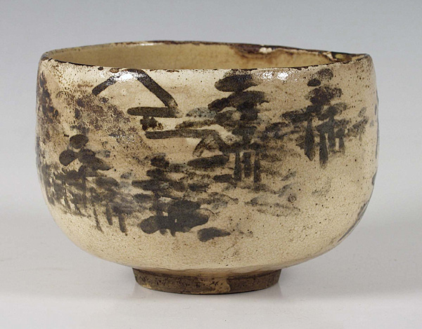
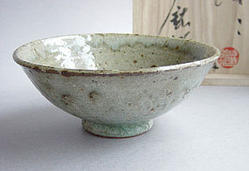
Popular bowl shapes

Slide 7
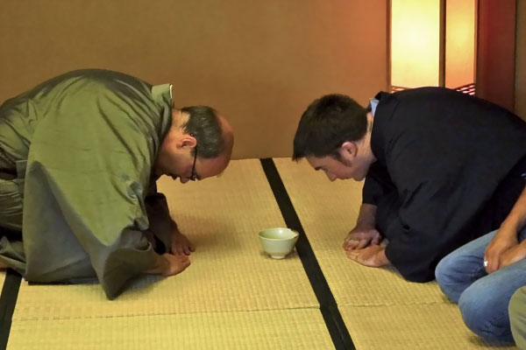
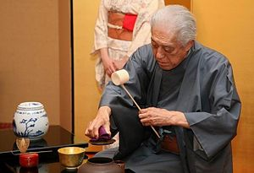
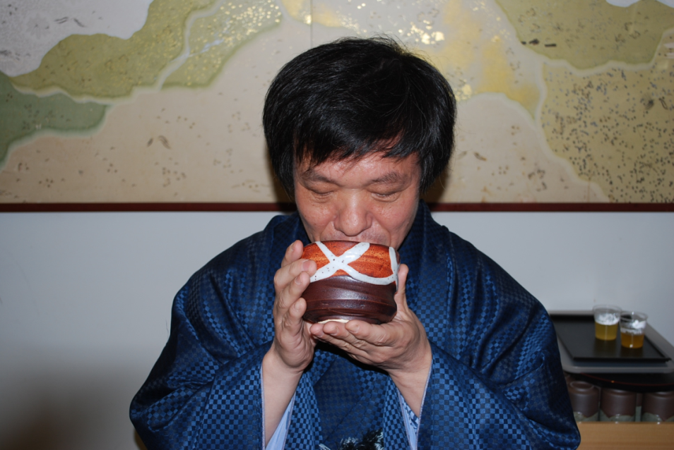
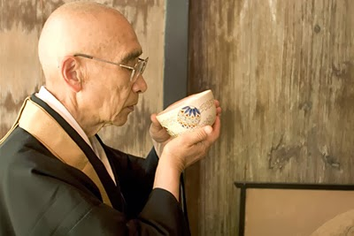
It takes 20 years to become a tea master

Slide 8
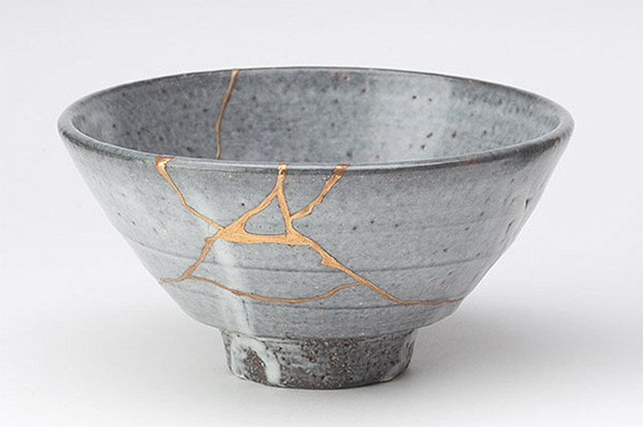
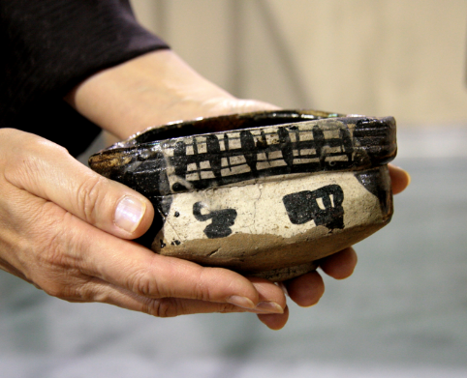
http://flyeschool.com/content/japanese-tea-bowl-shapes
There are many different tea bowl shapes.
  Chawan (tea bowls) created by Japan’s most famous potters can be worth hundreds to thousands of dollars.
  Often Hand built
  Have own personal character.
    Irregularities and imperfections are prized: they are often featured prominently as the "front" of the bowl.
    wabi-sabi is the Japanese art of finding beauty in imperfection… of accepting
    the natural cycle of growth,
    decay, and death.
  Designed to fit the hand well

Slide 9
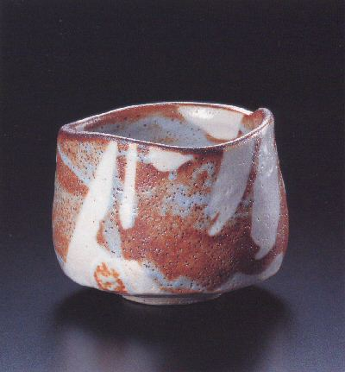
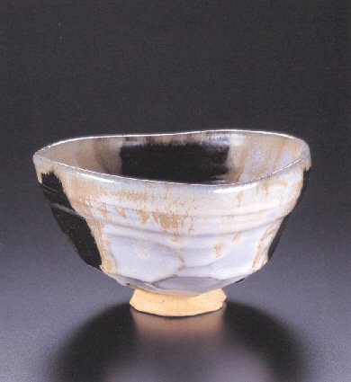
What’s the difference?
Winter Tea Bowl
Summer Tea Bowl

Slide 10
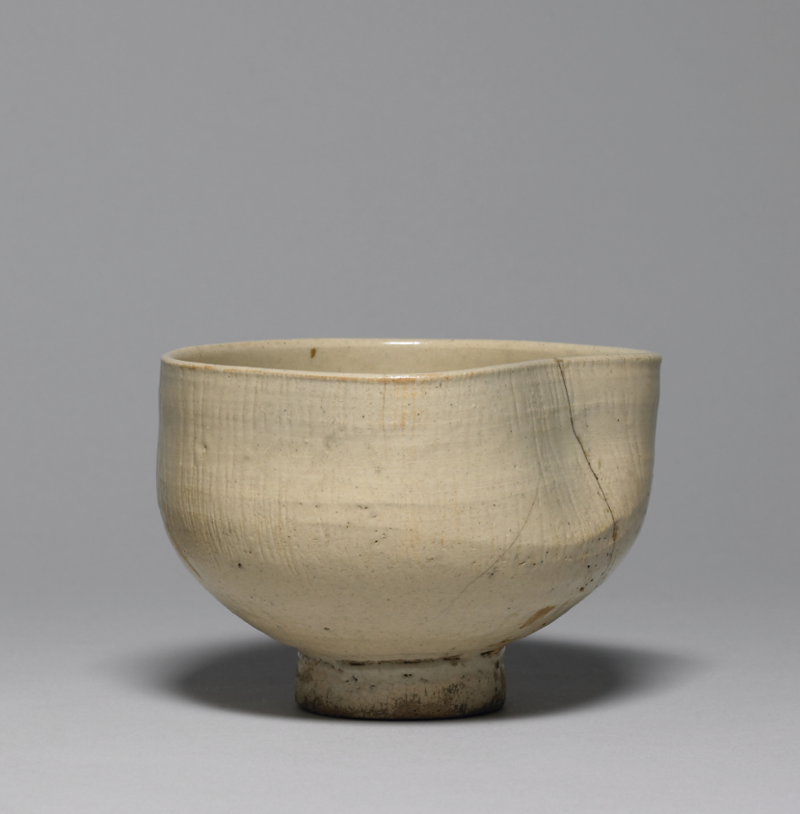
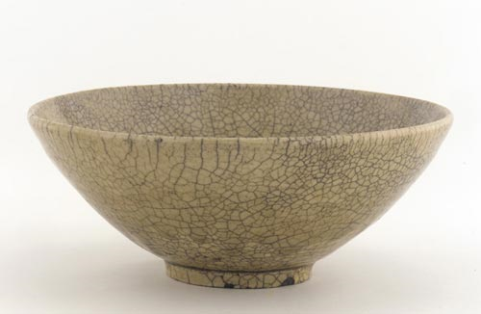
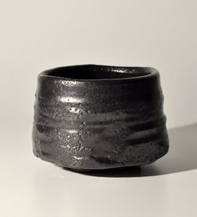
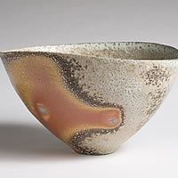
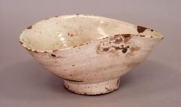

Slide 11
Create a pair of tea bowls that work together but are not exactly the same.
In Class Assignment
One bowl for summer and one bowl for winter.
Walls should be even; not thicker than your pointer finger and no thinner than your pinky.
Size: start with one pound of clay and use the pinch method.
There needs to be a linking quality about them (for example a similar texture or foot).
Tea Bowls need to have a foot, body and a rounded lip.
Bowls need to be round on the bottom (not flat) with a foot.
The glazes chosen should work for the season and also compliment each other.

Slide 12
